Slide 1
EE209 - Fundamentals of Electrical & Electronics Engineering
M. Mert ANKARALI, PhD

Slide 2
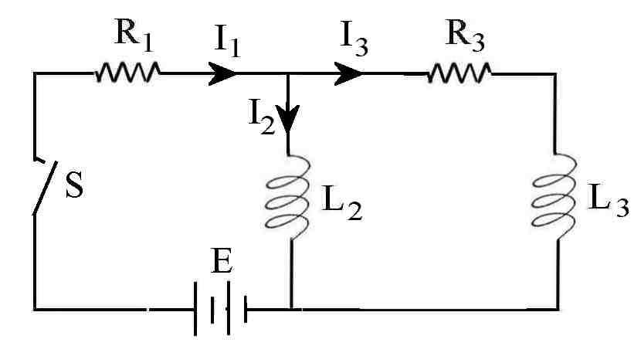
Typical electrical circuit
Interconnection of electrical elements

Slide 3
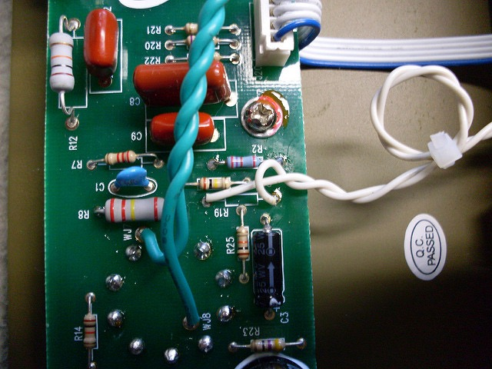
A more generalized view
Take the real world problem

Slide 4
A more generalized view
Simplify and represent it with a graphical model
The art of engineering

Slide 5
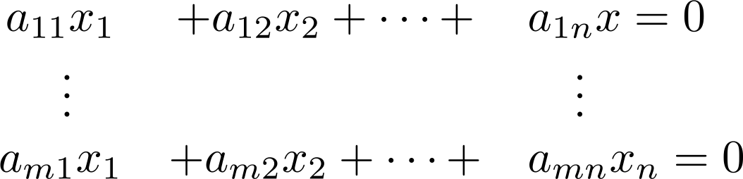
A more generalized view
Represent the graphical model using a parametric mathematical model and solve (i.e. analyze)

Slide 6
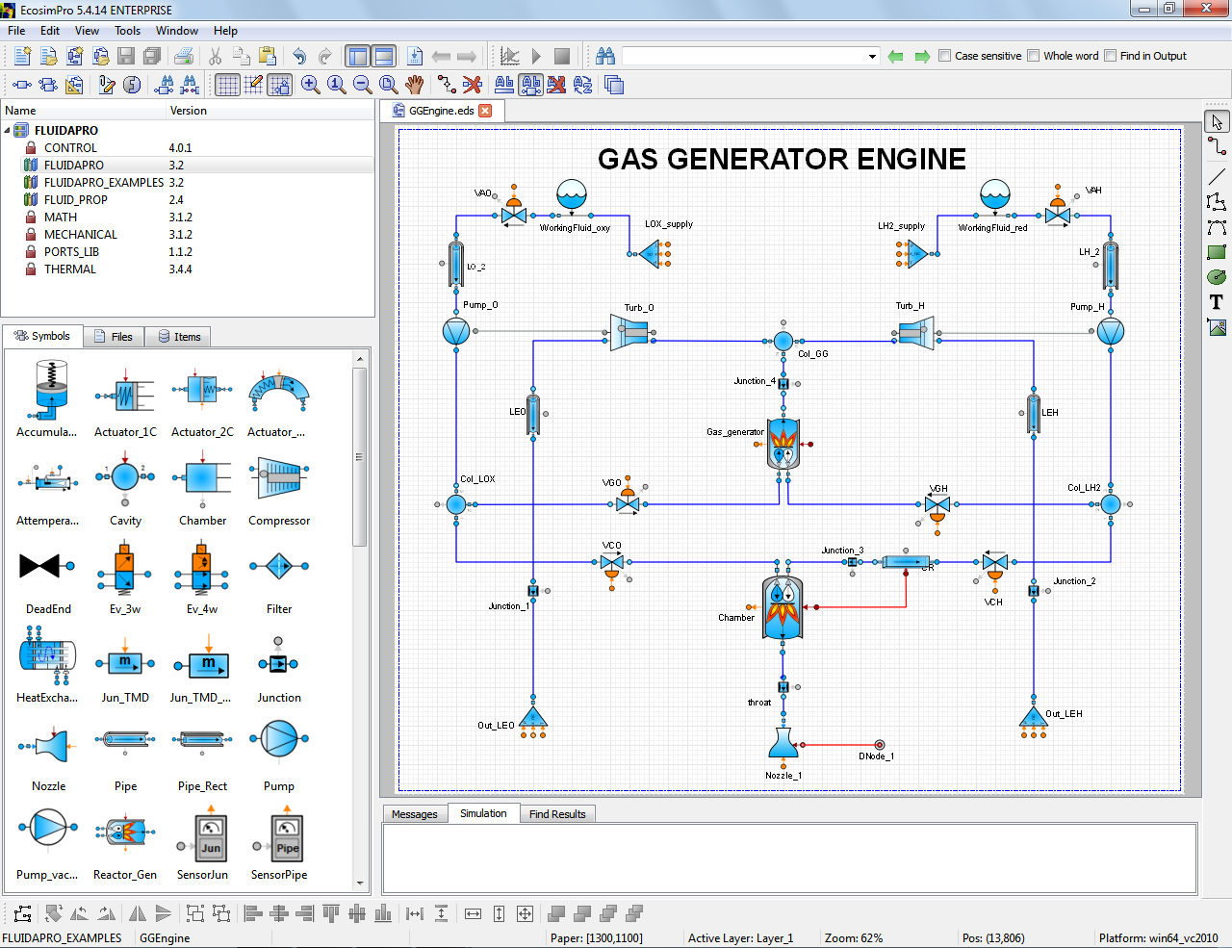

Not limited to electrical circuits
Thermal modeling of a thruster

Slide 7
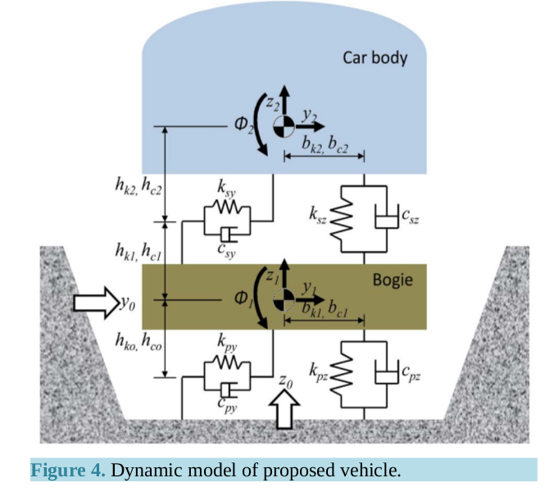
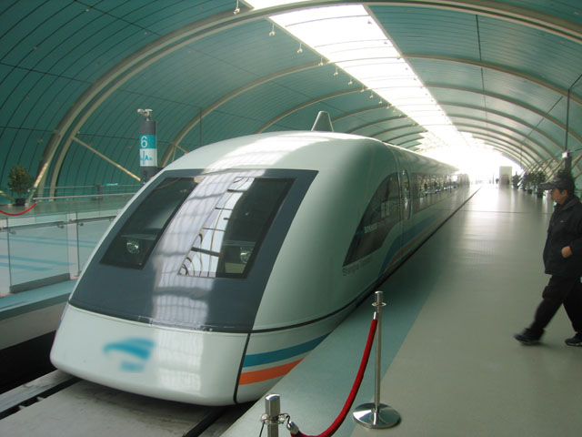
Not limited to electrical circuits
Mechanical modeling of a magnetic levitation train

Slide 8
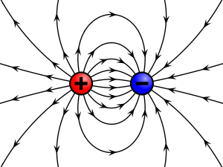
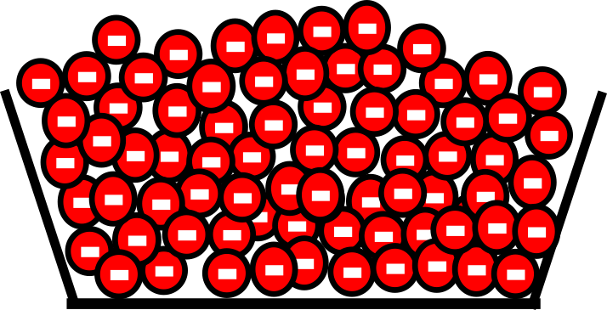
Electrical Charge
“Electric charge is the physical property of matter that causes it to experience a force when placed in an electromagnetic field” [https://en.wikipedia.org/wiki/Electric_charge]
The unit of charge is Columbs (C), which is equal to charge of 6.24×10¹⁸ electrons

Slide 9
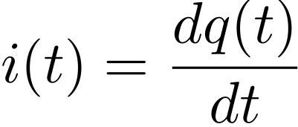
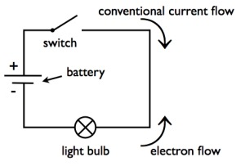
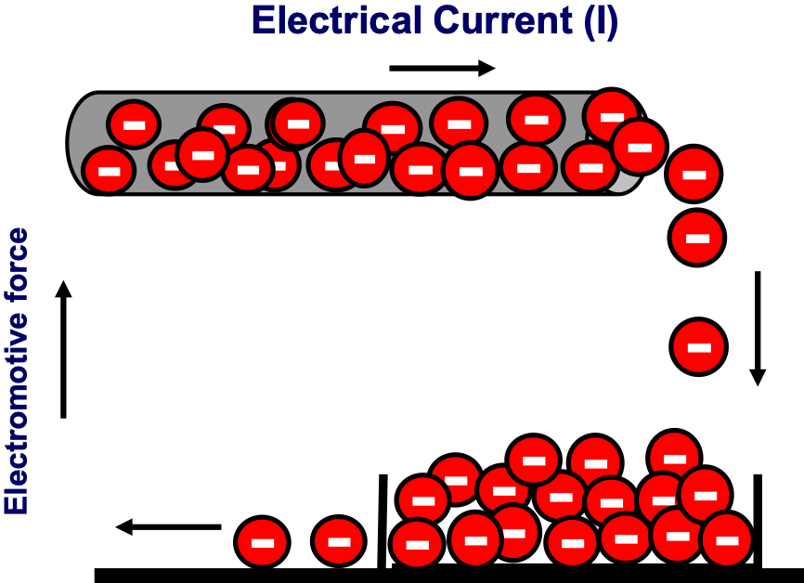
Electrical Current
Current is the rate of charge
Charge is carried by moving electrons
Unit of electrical current is Ampere (A)
1 A = 1 C/sec

Slide 10



Voltage Difference
Voltage is related to the strength of the electric field
Analogous to pressure in a hydraulic circuit
Voltage is always measured between two points, that is why it is also called potential difference.

Slide 11
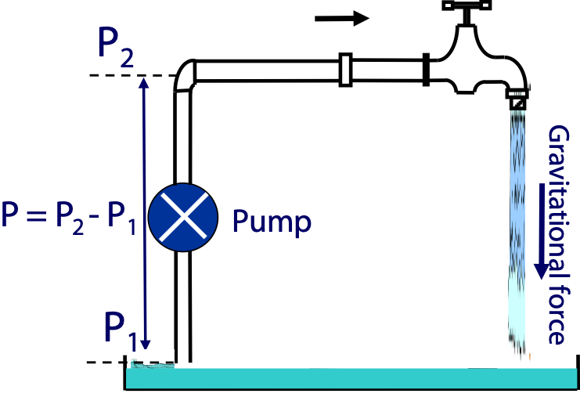
Analogy between electrical and hydraulic circuits
Voltage Difference = Pressure Difference
Electrical Current = Water Current
Resistance = Tap/Pipe Resistance

Slide 12
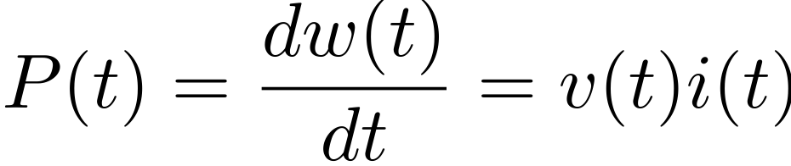
Power
P: Rate of change of energy (dissipating or absorbing)
Power of unit is Watt (W)

Slide 13
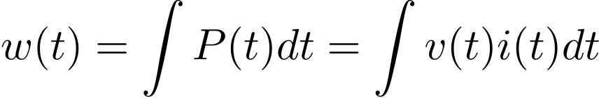
Energy
w: Unit of energy is Joules
Integral of power over time
It is also common to to express electrical energy in kilo-watt hours (kWh).

Slide 14
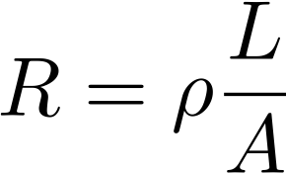
Resistance & Resistivity
Electrical resistance is the reaction/resistance of a conductor to an electrical current/flow
Voltage drop
Hydraulic resistance is the reaction/resistance of an element to the water current/flow
Pressure drop
Unit of electrical resistance is Ohm (Ω)
Resistance of an ideal uniform cable
L: length, A: Area, ρρ: Resistivity ( unit: Ω.m)
Ideal resistance in general ?

Slide 15
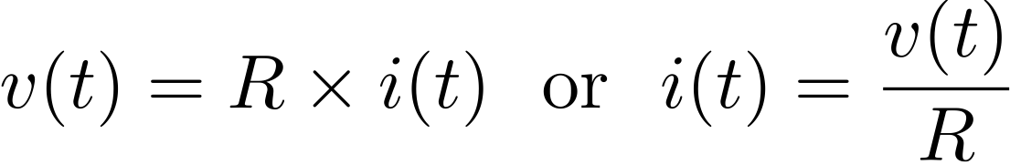
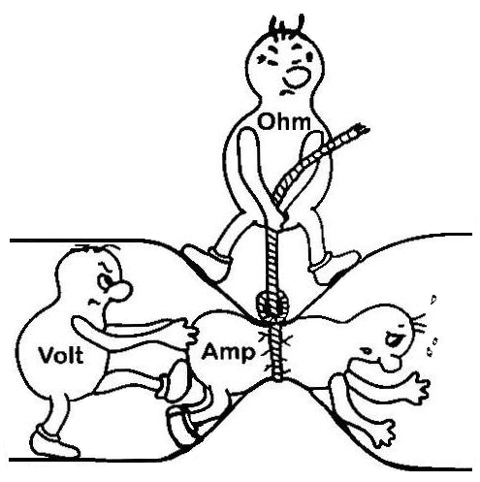
Ohm’s Law
There is a static/memoryless linear relationship between the flow current and voltage drop across a resistor

Slide 16
What is the best conductor?
Aluminium: 2.8210⁻⁸ Ω.m
Copper: 1.6810⁻⁸ Ω.m
Silver: 1.5910⁻⁸ Ω.m

Slide 17

What is the best conductor?
Aluminium: 2.8210⁻⁸ Ω.m
Copper: 1.6810⁻⁸ Ω.m
Silver: 1.5910⁻⁸ Ω.m
Gold: 2.4410⁻⁸ Ω.m
Why gold?

Slide 18
What is the best conductor?
Aluminium: 2.8210⁻⁸ Ω.m
Copper: 1.6810⁻⁸ Ω.m
Silver: 1.5910−8 Ω.m
Gold: 2.4410⁻⁸ Ω.m
Why gold?
Corrosion

Slide 19
Terms in circuit diagrams
Node: Point of connection between elements.
Branch: Connection between two nodes.
Loop: Closed loops in circuit diagram.
Number of Branches = # of Loops + # of Nodes - 1

Slide 20
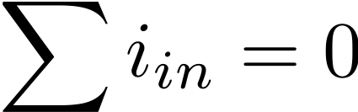
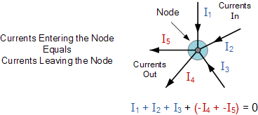
Kirchhoff's Current Law
Algebraic sum of currents entering a closed a node (or a loop) is zero

Slide 21
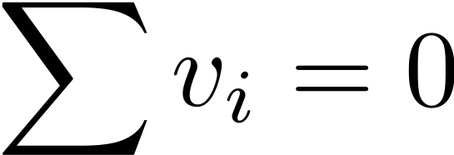
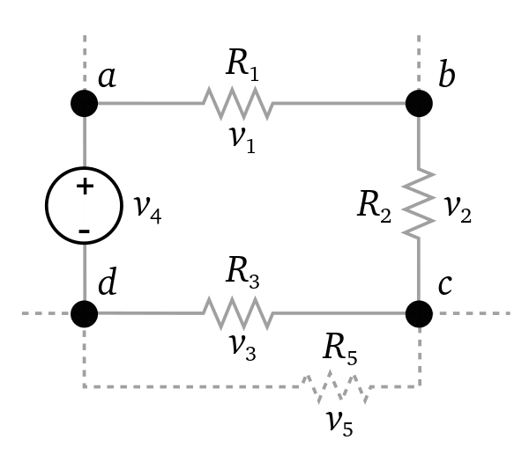
Kirchhoff's Voltage Law
Algebraic sum of all voltages around a closed path (or loop) is zero.

Slide 22
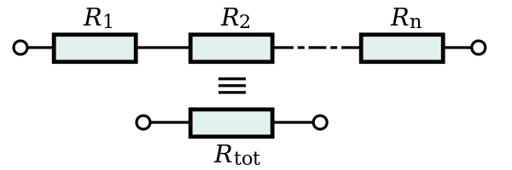
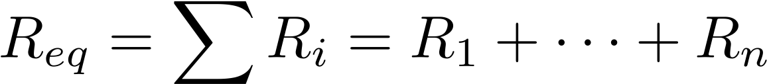
Series resistors

Slide 23
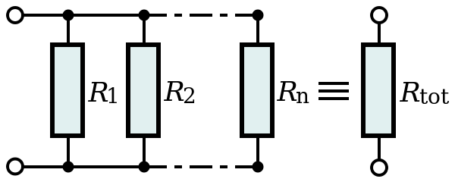
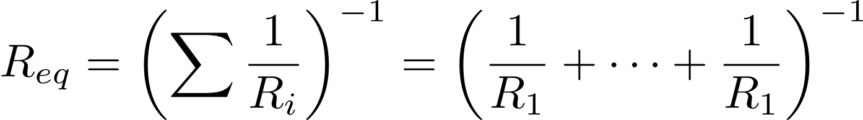
Parallel resistors

Slide 24
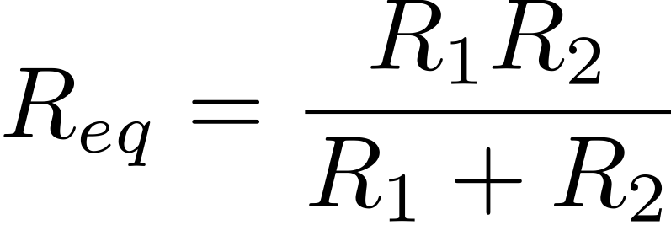
Parallel resistors
Two resistors

Slide 25
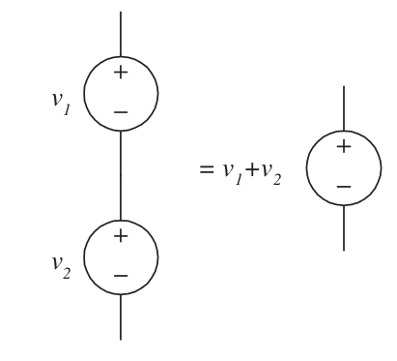
Connection of Voltage Sources
Series voltage

Slide 26
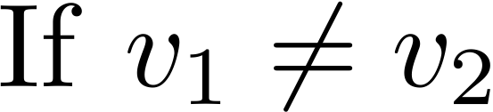
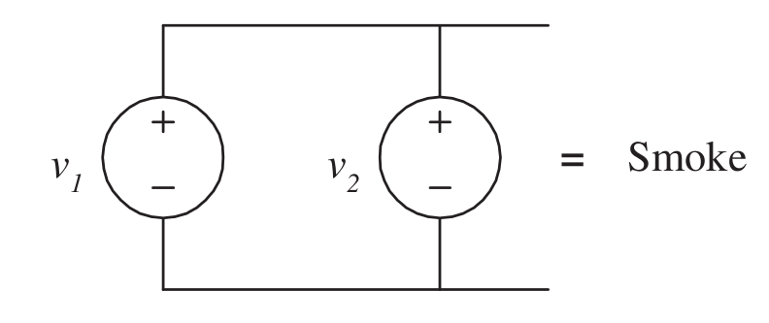
Connection of Voltage Sources
Parallel voltage

Slide 27
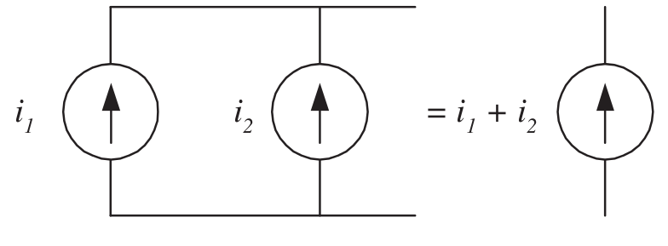
Connection of current sources
Parallel current source

Slide 28
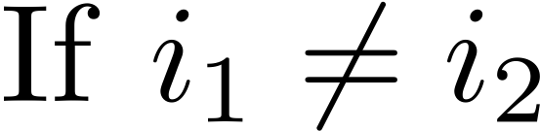
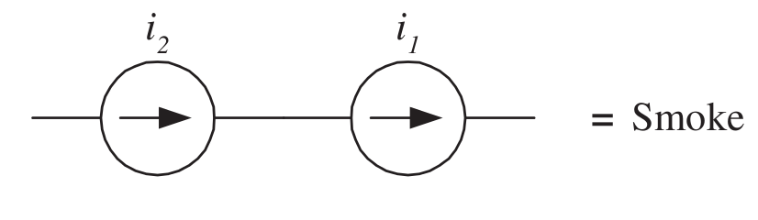
Connection of current sources
Series current source

Slide 29
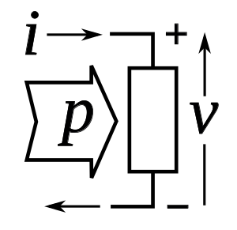
Passive sign convention
(Passive) resistors cannot produce power, only consumes it !
!Current enters the positive voltage terminal

Slide 30
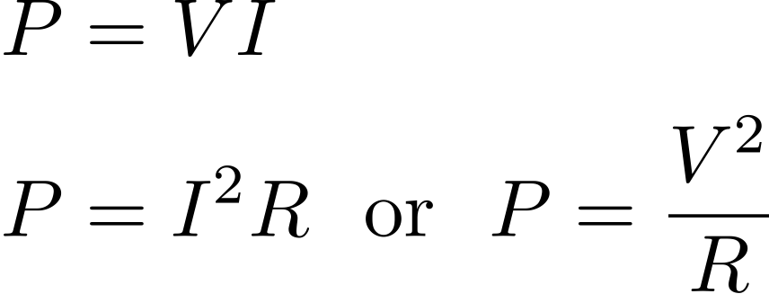
Power
(Passive) resistors cannot produce power, only consumes it !
Absorbed Power for a Resistor > 0

Slide 31
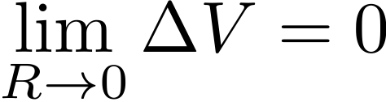
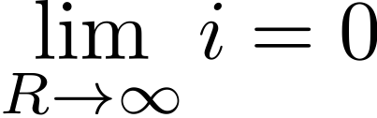
Short/Open circuit
Short circuit: Resistance & voltage drop
Open circuit: Resistance & current

Slide 32
Questions ?

